Slide 1

Find Your Dublin
Group 1 MSc Team Project

Slide 2
Updates in recommendation system
What we did
8 → 12
areas covered (added D11–D14)
Collected rent data from Daft ie for D11-D14
Changed the accommodation types in the code so the same area doesn’t repeat
Added D11–D14 to the recommender code
4 → 6
room types students can pick
2

Slide 3
Running API
Push to GitHub
GitHub Actions
Azure App Service
→
→
any change on main
builds the app
API goes live at /docs
Problem | What I found | Fix
Deploy failed at login | Repo had moved accounts, so Azure no longer trusted it | Moved the repo back to the team organisation
Site showed "Service Unavailable" | Log stream: "can't chdir to Backend". The server folder only had a half-finished upload | Re-ran the deploy and stopped uploading during it
Deploy stuck for 25 min | The frontend upload got sent to the backend server too | Workflow now skips the Frontend and Presentation folders
3

Slide 4
Ready to host
Done
Next
API is ready for the frontend, /options fills the form and /recommend returns the top 3
Frontend moved into the right folders, ready to be deployed
District profile page and map data moved into the main site
University names matched between the form and the data
Add rental data of remaining regions.
4

Slide 5
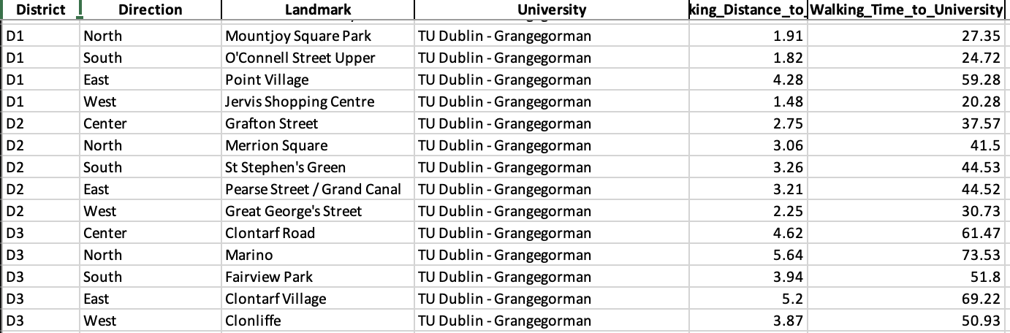
Commute Data – Walking time to Uni
From last week’s feedback, we were asked to include the walking distance and time to University from respective district points.
I used OpenTripPlanner which is a routing engine that calculates the walking distance using the openstreetmap data.

Slide 6
Amenities data and Interim report
The remaining amenities data from D11 to D24 was taken using the OpenStreetMap by querying.
Then interim report has been started. Past interim reports magpie, renting made easy were read.
I have started drafting the conclusion part

Slide 7
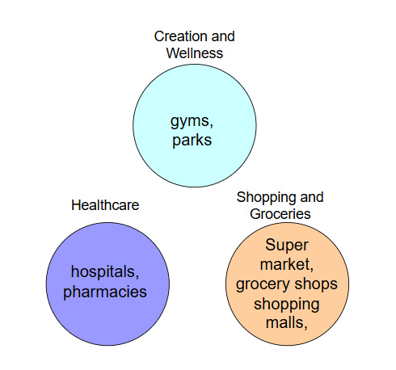
Before: Students would have to rate around 10 separate amenities
Categorized amenities into 3 groups.
The group score average its parts.

Slide 8
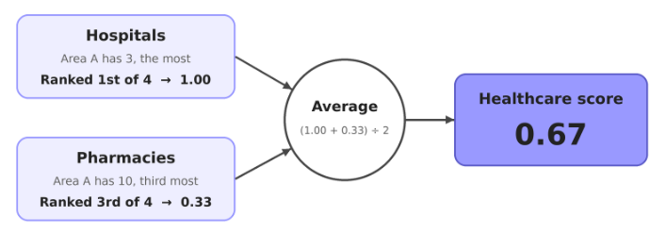
How a group score is calculated?

Slide 9
Expanding the data:
Now: amenity data for D1–D24
The recommender can compare the whole city
Walking distance from each area to the chosen university, shown with the results
Added universities across Dublin, so students at any campus can use it

Slide 10






Frontend stack & deployment
React
Vite
JavaScript
UI components
Dev server + build
Interactions
React Router
Azure Static
Web Apps
CSS
Styling
Page navigation
Live hosting
Code editor
Hosting
Visual Studio Code
Azure Static Web Apps

Slide 11
Next Week Vision
What we did this week?
Home page
Login / Sign up page
How it Works page
Questionnaire page
District Explorer page
User Preferences page
Recommendation page
Comparison page
Interim Report

Slide 12
Feedback for Frontend from a Former Student of TUD
Her Perspective as a former student: She came to Dublin around three years ago when students like her had less social media exposure, she had a friend here who guided her.
Positive feedback: She was happy that we are taking initiative to help future students to settle and make informed decisions.
What students will expect: Consistent, easy to compare district information and a simple journey from preferences to suitable areas.

Slide 13
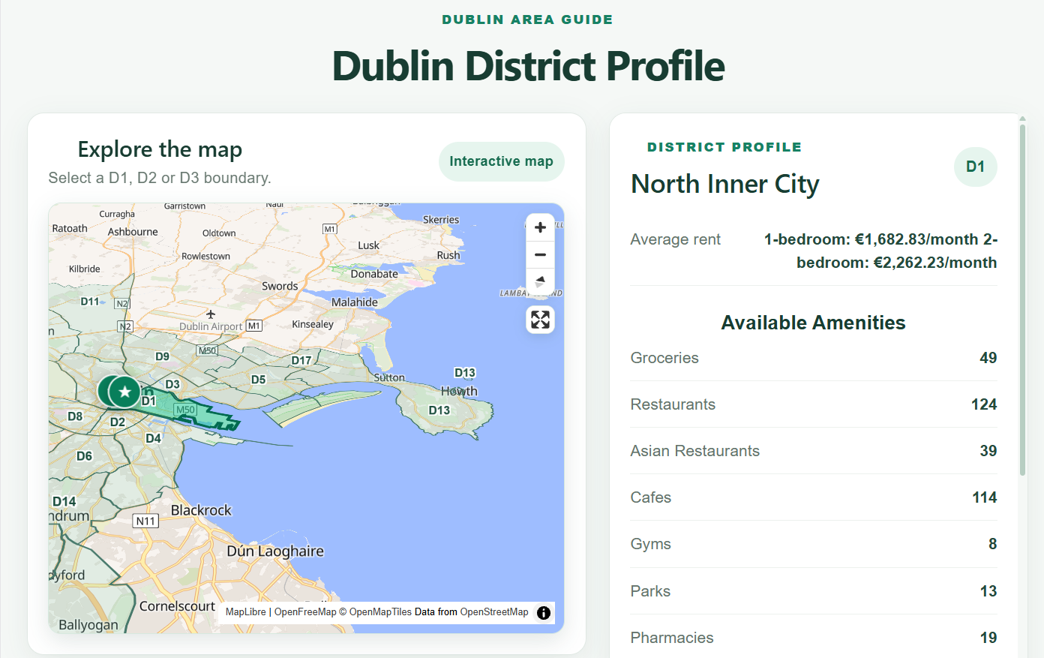
Frontend Development: District Profile Page
User Interface:
Developed the frontend using React.js, JavaScript and CSS.
Designed a two-panel layout with an interactive map on the left and a district profile on the right.
Displayed district information, including rent, available amenities and famous places.

Slide 14
Interactive Map and Animation
Map Integration and District Selection:
For the Map , I used MapLibre GL JS with the OpenFreeMap Liberty map style.
Integrated GeoJSON data to display Dublin district boundaries.
Used proj4 to convert boundary coordinates.
Implemented clickable district boundaries to select a district and update its profile.

Slide 15
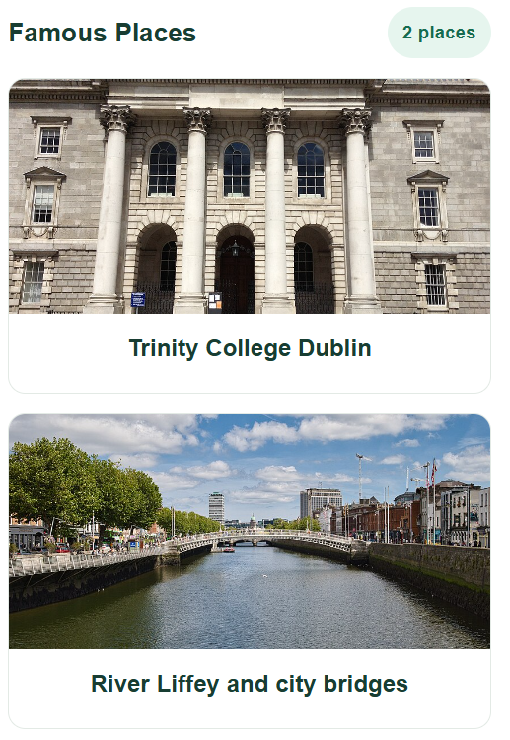
Famous Places and Images
Displayed famous places relevant to each district.
Integrated place images using URLs stored in the district data.
Used reusable React components to display images and place names.

